Slide 1
Year 10 History
World War 2: Atomic Bomb

Slide 2
Review
The bombing of Pearl Harbour by Japan in December 1941 was the beginning of WWII in the Pacific.
First 2 years of the war, Japanese forces occupied Malaya, Singapore, Hong Kong, the Philippines, Guam and Wake Island.
Then conquered Burma, French Indochina and the Dutch East Indies to reach Australia’s doorstep in New Guinea.

Slide 3
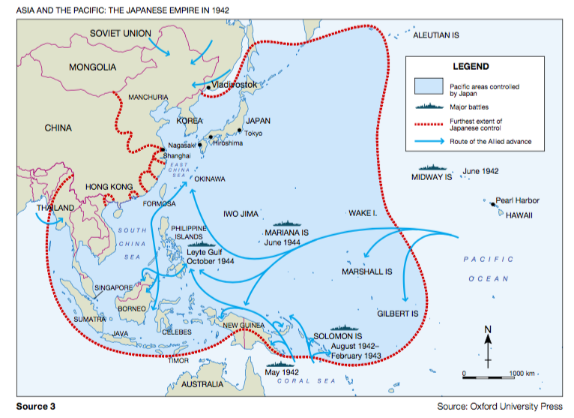

Slide 4
Fall of Singapore
Singapore surrendered in 1942
More than 130 000 allied troops (15000 Australians) became prisoners of war.
Cause of great concern for Australia
Strong British presence, therefore Australia felt protected
Could no longer depend on Britain, needed new allies against Japan

Slide 5
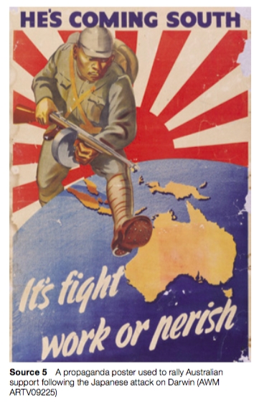
Darwin Bombings
After fall of Singapore, there began an evacuation of women and children from Darwin and surrounding areas in fear of an attack.
19th Feb, 1942, Japan launched assault on Darwin
Approx. 250 people killed.
By 1943, Darwin had suffered 64 air raids. Other towns in the NT, QLD and WA were also struck.
Overall 900 allied troops and civilians killed.

Slide 6
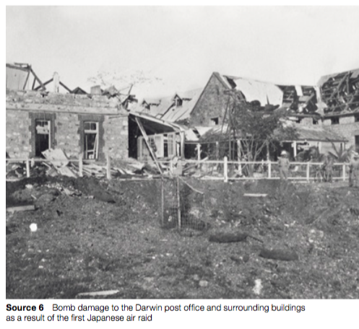

Slide 7
War in Sydney Harbour
May 1942, three Japanese submarines entered the harbour.
Sank a ferry carrying military personnel (killing 21 people).
One week later, two submarines struck several Sydney suburbs
No damage done, but Australia realised that war was close to home.

Slide 8
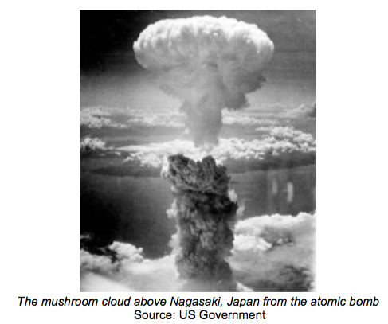
The atomic bombings
The dropping of the atomic bombs on the Japanese cities of Hiroshima and Nagasaki is remembered as one of the most significant events of WWII.
https://www.youtube.com/watch?v=t19kvUiHvAE

Slide 9
The atomic bombings
At the start of WWII in 1939, the atomic bomb had not yet been invented
Scientists made the discovery that a powerful explosion might be possible by splitting an atom
Could destroy large cities in a single blast and would change warfare forever

Slide 10
The first atomic bomb was trialled by the USA.
July 16, 1945 the first atomic bomb was exploded in the New Mexico desert (in the USA) after three years of research.
Temperature at the centre of the explosion was three times hotter than the centre of the sun
Scientists were fearful that they had created something that would cause mass destruction and death.

Slide 11
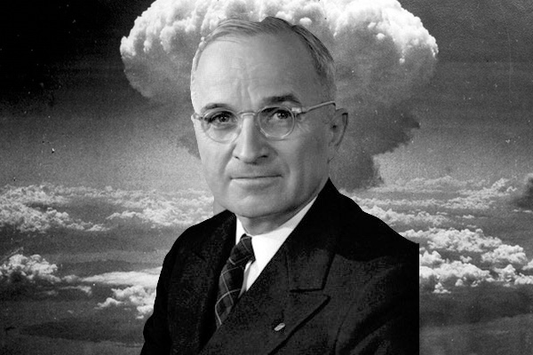
Deciding to drop the Bomb
By the time the first atomic bomb had been made, Germany had already surrendered WWII in Europe
Japan was also defeated, but would not surrender (even after air raids caused the deaths of thousands of civillians)
The US was considering invading Japan, however they believed that too many soldiers would die in the process.
President Truman decided to drop the atomic bomb instead.

Slide 12
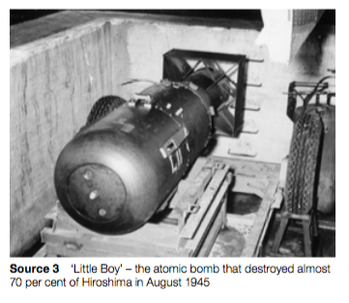
Hiroshima
August 6, 1945, ’Little Boy’ was dropped on Hiroshima.
Hiroshima chosen as it was a large, urban, industrial city which was also used for military storage
City destroyed and approx 80 000 killed , 70 000 injured
Many people also suffered from burns, radiation, cancer and many other side effects.

Slide 13
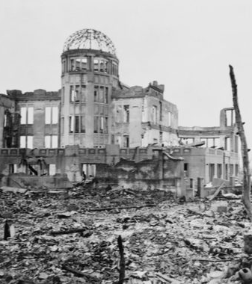
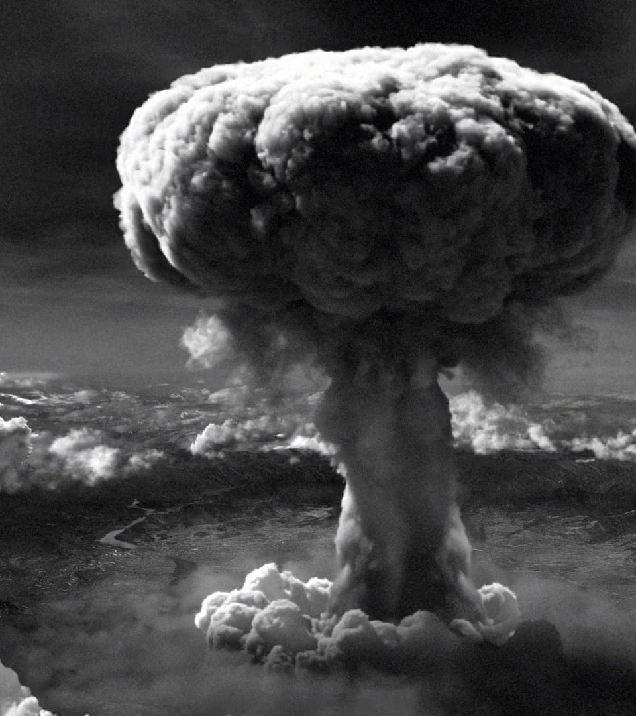

Slide 14
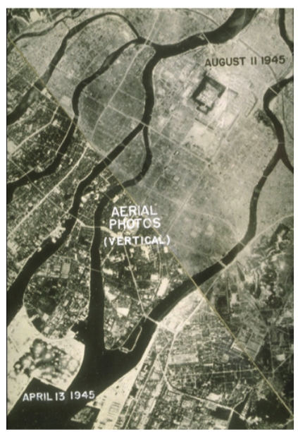
Hiroshima before and after the atomic bombing

Slide 15
Nagasaki
Despite witnessing the terrible destruction of Hiroshima, Japan still refused to surrender.
3 days later, another atomic bomb ‘Fat Man’ was dropped on Nagasaki.
40 000- 70 000 people killed by immediate effects

Slide 16
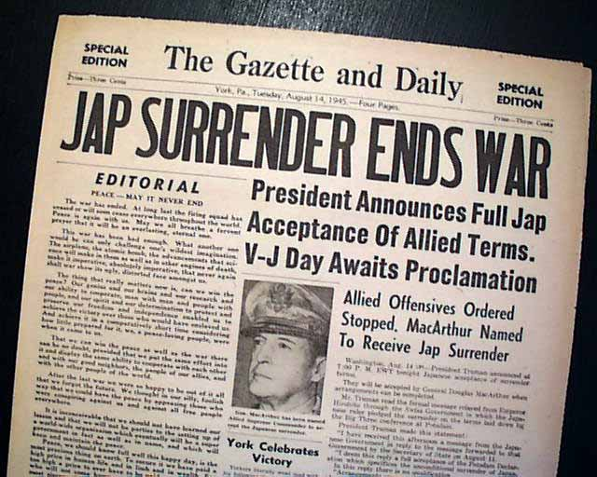
Japan surrenders
6 days after Nagasaki, on the 15th of August, 1945, Japan surrendered to US forces.
The formal declaration of surrender was signed on the 2nd September and the Allies occupied Japan from that date until 1952.

Slide 17
Debate
Immediately after WWII ended, most US citizens supported the use of the atomic bombs.
Images of survivors were censored and many were so used to anti-Japanese propaganda that they felt little empathy for the victims.
Since then, however, there have been fierce debates over whether the atomic bombings were justified or necessary to end the war.

